Slide 1


Mythos Consulting Group
Group 7
Jay Vachhani, Maryam Almoree, Ralph Lowe, James Turcotte, Victoria Rousseau, Kanchan Sharma

Slide 2
Presentation Contents
Mythos Mission Statement
Overview of Disney+
Internal Analysis: VRIO, Value Chain
External Analysis: PESTEL, Industry Life Cycle
Strategic Problems
Formulation of a New Strategy
Strategy Implementation

Slide 3
Mission Statement
Our mission is to empower businesses with strategic advice and guidance, helping them navigate the ever-changing business landscape and achieve sustainable growth.

Slide 4

Overview
Disney Plus is a streaming service that was Launched in November 2019 by the Walt Disney Company in response to the growing demand for digital streaming. Disney plus had an impressive start, gaining over 10 million subscribers on its first day and was built on the foundation of Disney's rich legacy and exclusive content.
179 Million Subscribers (Q3.2023)
1400 movies & 576 shows
16 Languages
60 countries

Slide 5
Business Model
Disney+ operates on a subscription-based business model, where users pay a monthly or annual fee to access their streaming service
Revenue Streams
Monthly subscription (Basic or Premium)
Annual subscription
Bundled Subscription with Hulu and ESPN+
Key Resources
Streaming platforms
Content Library made by Disney, Pixar, Star Wars, Marvel, National geographic and more.
including movie rights

Slide 6
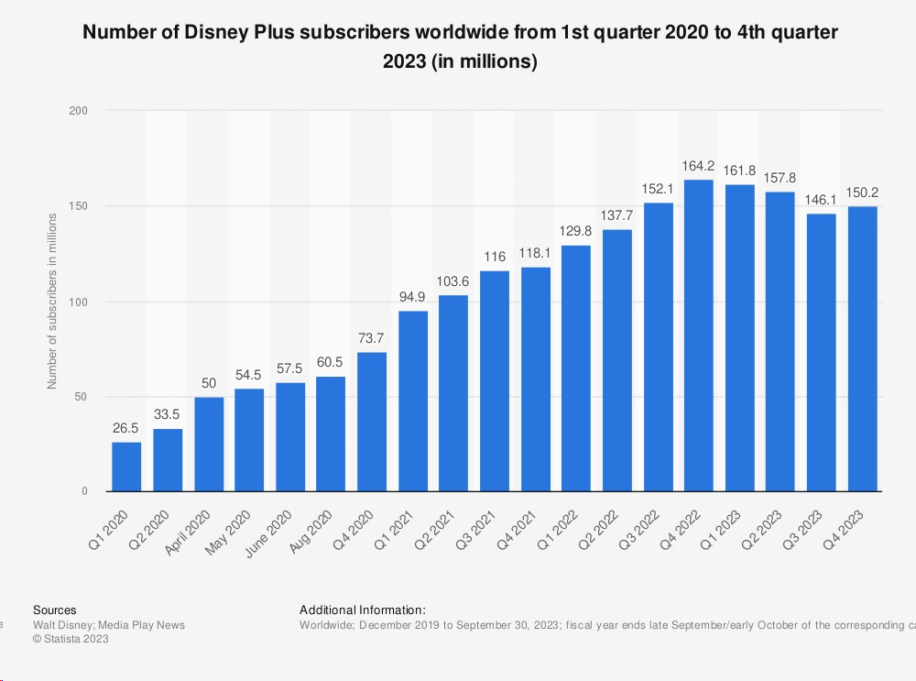
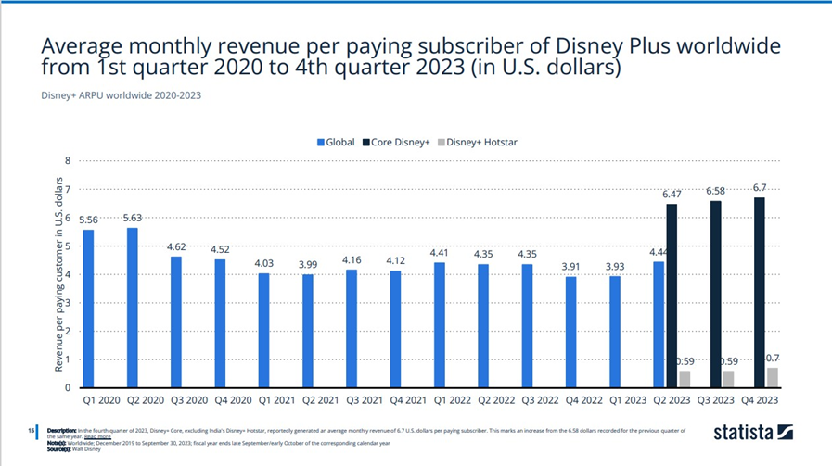
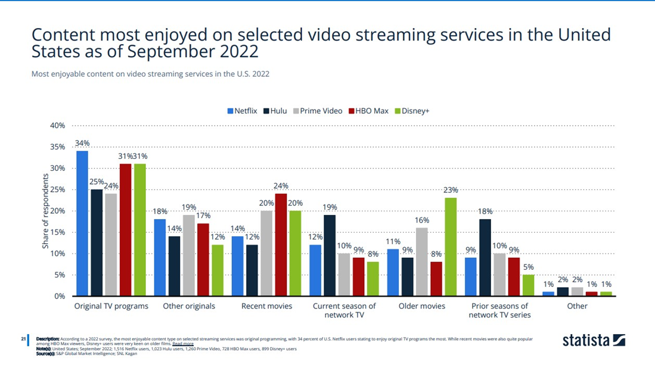
Industry Attractiveness

Slide 7
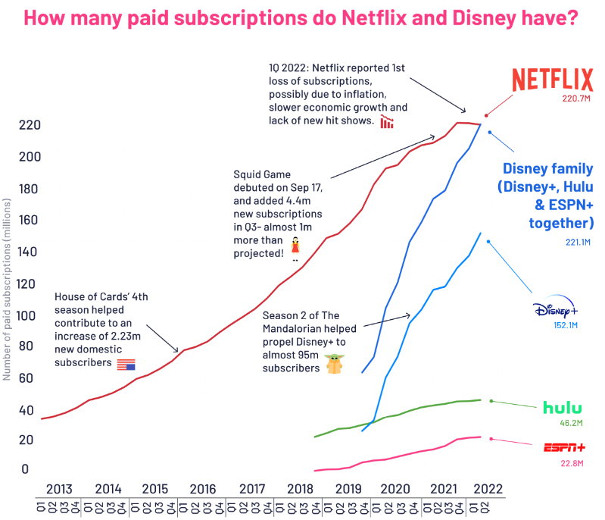
Business Unit Strength

Slide 8
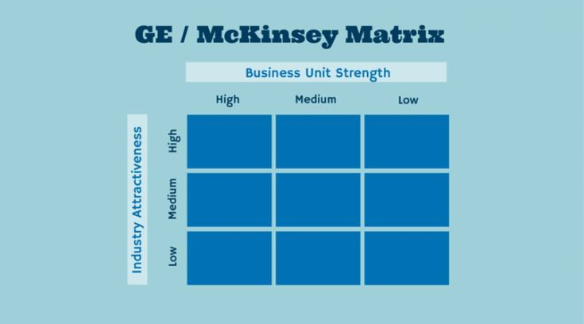

GE McKinsey Matrix

Slide 9
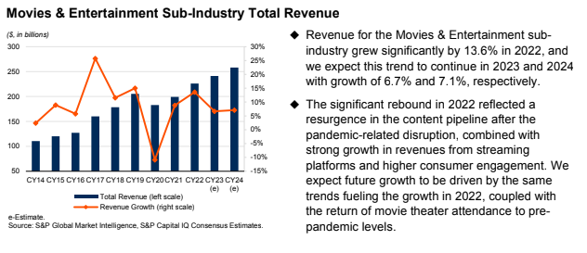
Industry Overview

Slide 10
Internal Analysis - VRIO
Value - Large content library, built in fan base, Hulu, ESPN
Rarity - Cannot replicate 100 years of intellectual property
Imitability - Costly to imitate, but getting cheaper due to technological development
Organization - Good at leveraging existing fan base but has struggled bringing in new subscribers, extensive existing infrastructure

Slide 11
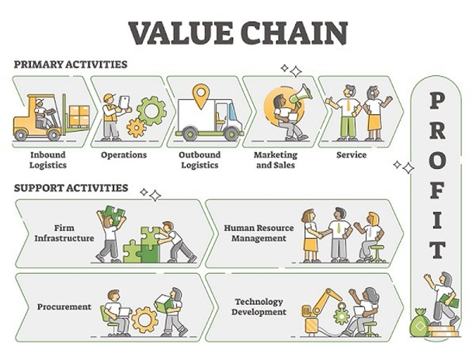
Internal Analysis- Value Chain
Inbound Logistics:
Procurement of content, including movies, TV shows, and original productions, through partnerships, licensing, and in-house production.
Operations:
Creation of original content and the organization of a diverse library of movies and TV shows.
Outbound Logistics:
Streaming and delivering content to subscribers through the Disney+ platform.
Marketing and Sales:
Advertising and promoting Disney+ to attract and retain subscribers.
Managing subscription plans and customer sign-ups.
Service:
Providing customer service and support for technical issues or inquiries.
Regularly updating the content library to keep it fresh and appealing to subscribers.

Slide 12
External Analysis- PESTEL
Political
Disney+ operates in various countries, each with their own set of regulations related to streaming services, content distribution, and digital media.
Political stability.
Economic
Economic factors such as inflation rates, exchange rates, and the overall economy can influence consumer spending.
Income Levels.
Sociocultural
Content needs to be tailored to diverse cultural preferences to attract a global audience.
Preferences of different age groups.
Technological
Staying updated with the latest technological trends.
Ensuring the security of user data.
Environmental
Environmental Sustainability and Corporate Social Responsibility.
Legal
Copyright laws and protection of intellectual property.
Data protection and privacy laws.
Notes:
Disney+ relies on technology for content delivery.

Slide 13
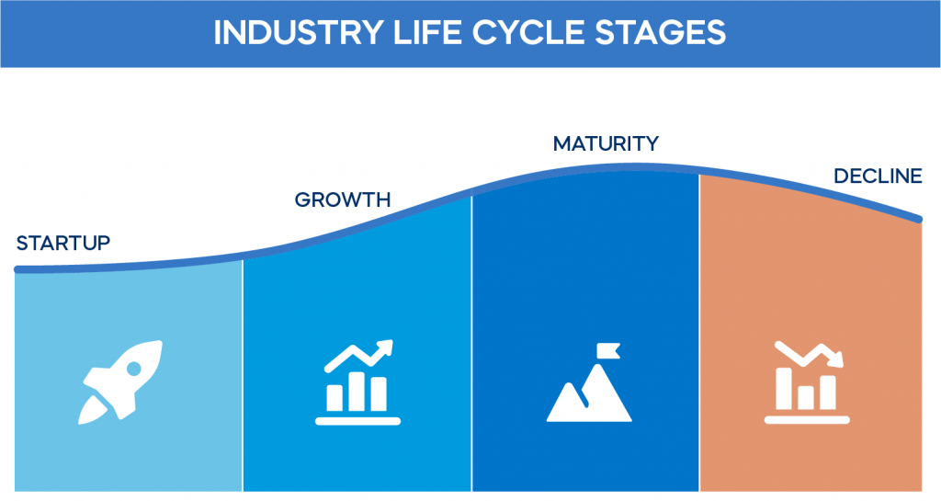
External Analysis - Video Streaming Industry

Slide 14
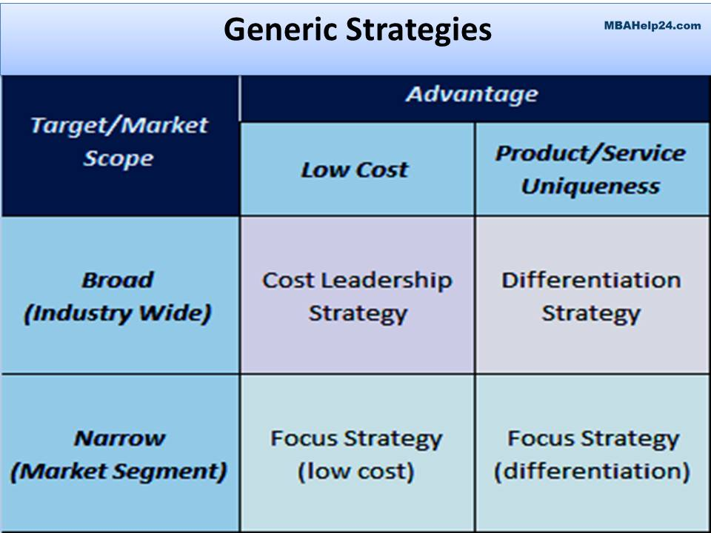
Formulation
Proposed Strategies
Differentiation
Expanding the content library
Advanced Analytical Technology
Differentiation Focus Strategy
Adding interactive additions to the platform
Targeted revenue generating features
Notes:
For our formulation of a strategy we started with analyzing two generic strategies of differentiation and focus differentiation strategies. We wanted to understand the positioning and what we would want to achieve utilizing either strategies and what that would look like for Disney+. Going through this exercise helped us to narrow down our ideas for what would be a successful strategy for Disney.

Slide 15





Formulation: Differentiation Strategy
A differentiation strategy would be achieved by doing the following:
Broad Appeal
Adaptability to Consumer Preferences
Consumer-Centric Approach
Agile Strategy Implementation
Willingness To Pay (WTP) Enhancement
Notes:
In order to position Disney+ for a differentiation strategy we would need to accomplish the following, having broad appeal to a larger customer base. Having the adaptability to serve a larger customer base by having the technology to have analytics to customer preferences for a personalized customer experience for more potential customers. Implementing this would require us to be agile by pushing out large amounts of content to support this model. And overall with the implementation of this type of strategy we would have a larger willingness to pay which would support a larger and more expensive strategy like the differentiation strategy.

Slide 16
Strategic Choice Cascade: Differentiation Strategy
Aspirations & Goals
Make everyone experience the joy of Disney at any age
Playing Field
Broad Customer Segments
Unique Right to Win
Disney is a household name for all ages
Capabilities
Content Creation
Management Systems
Advanced Data Analytics
Notes:
To support this strategy and think of the different variables that would factor into it we brainstormed utilizing the strategic choice cascade tool. The management system that we would need have a competitive advantage in would be a more advanced data analytics system to provide that personalized experience to a larger amount of consumers. The capability we would need to be successful would be content creation, implementing a way to produce high volumes that would serve more customers. Our right to win is that Disney is a big household name today and we would want to have Disney be for everyone no matter what their preferences. And finally our aspirations and goals of this would have everyone experience of the magic and joy of Disney, giving that nostalgic experience as well as keeping us with changing preferences throughout our consumers lives.

Slide 17

Formulation: Differentiation Focus Strategy
In order to position Disney+ for a differentiation focus strategy and secure Disney Plus’s position as an outstanding and indispensable streaming service in the ever-evolving entertainment landscape.
Interactive Features
Target specific lifestyle preferences for subscribers through unique content.
Integrate Disney+ to more of a lifestyle so subscribers are using the platform more regularly and for longer period.
Targeted Revenue Generation
Offer fun and unique ways to engage with the platform with rewards for customer loyalty
Notes:
In order to position Disney+ for a differentiation focus strategy we would need to accomplish the following, Interactive Features and targeted revenue generation by offering fun and unique ways to engage customers with the platform to secure Disney Plus’s position as a unique and indispensable streaming service in the ever-evolving entertainment landscape.

Slide 18
Strategic Choice Cascade: Differentiation Focus Strategy
Aspirations & Goals
Have Disney+ be more than just a watching experience
Playing Field
Targeted Consumer Segments
Unique Right to Win
Disruption in the Streaming Industry
Capabilities
Marketing for Consumer Awareness
Management Systems
Data Analytics for Consumers

Slide 19
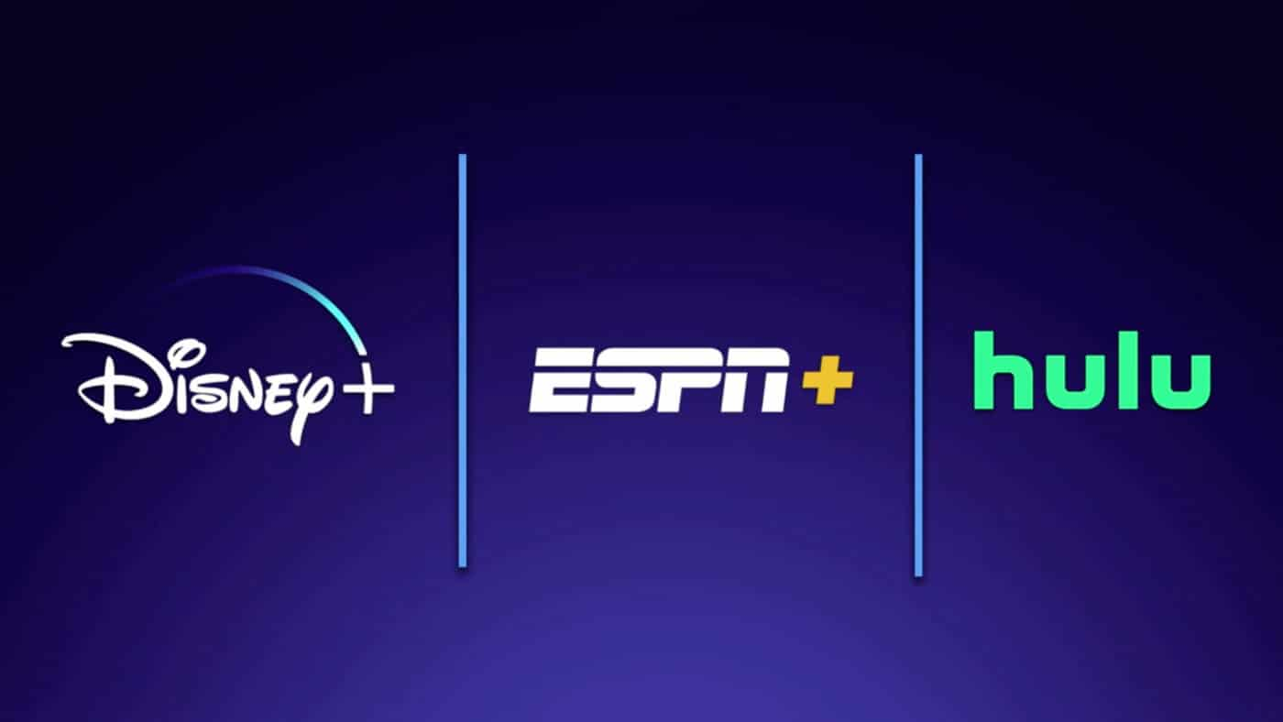

Implementation of Strategy
Add interactive additions to the platform
Build Metaverse for Disney World
Interactive games, Contests
03
Expanding the content library
Merge Disney+, Hulu, & ESPN
.
01
02
Targeted revenue generating features
Referral Programs
Pay per view facility

Slide 20

Implementation of Strategy: Potential Risk and Threats
Expanding Library
1.Content licensing agreement: Restrictions from existing agreements with third-party creators.
Solution: Curate bundles of selected contents.
Targeted revenue
generation
1.Competitive response: Aggressive referral/benefit programs from other companies. 2. Alternate Platforms: Users seeking alternate platforms which are less lenient.
Solution: Increasing value proposition by offering unique contents & discounts.
Interactive additions
1. Infrastructure cost: Hard to meet huge infrastructure cost. 2.Technology Learning curve: User adaptation can cause aversion.
Solution: Incremental approach to integrate & user friendly UIs.

Slide 21
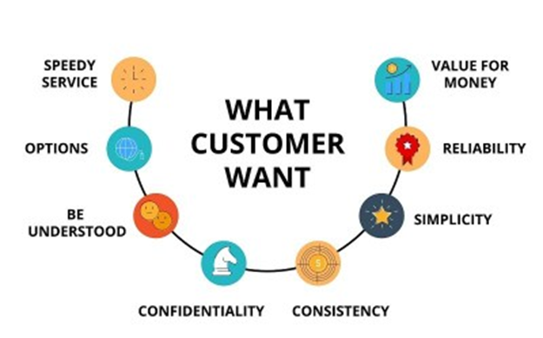
THANK YOU!

Slide 22
Video recording link:
https://uconn-cmr.webex.com/uconn-cmr/ldr.php?RCID=d6d7cabcfe1f3f58d748c4d855531b2a

